Slide 1


Enhancing Pandas Dataframes with Auto Indexing
Kiran Bodipati, Shruti Jain, Shashank Kambhammettu, Jai Narayanan
Notes:
shashank

Slide 2
Introduction
01
Notes:
shashank

Slide 3
Introduction
?
About Pandas
The Problem
Pandas is a fast, powerful, flexible and easy to use open source data analysis and manipulation tool, built on top of the Python programming language
Pandas is now being used for large datasets and complex tasks which it is not optimized for.
Notes:
shashank

Slide 4
Prior Works
Faster Dataframes
Index Suggestion
Polars
Cylon
Bodo
Dask
Pandralel
Missing Indexes (MI) and Database Tuning Advisor (DTA) in Microsoft Azure
Notes:
shashank

Slide 5
Our analysis
How Pandas Works
Pandas row accesses for range and equality queries compute a boolean mask by going through each row and seeing if it meets a condition. This is slow but can be significantly be sped up with indices.
Pandas has no auto indexing beyond assigning each row a number as an index.
Users often do not create indices manually because workloads can be dynamic.
Notes:
shashank

Slide 6
Solution Idea
02

Slide 7

Overall Idea
extended-df class
5. values returned to user
pandas df object
persist
index tracking table
3. query sent to pandas df object
1. user sends a query
index creation
4. update tally in index tracking table
query_analyzer()
2. query analyzer is called
manually created indices
index_suggestor()
index creation

Slide 8
Tracking accesses
Track any accesses to columns using
df[‘column’] or df[['col1', 'col2']]
df[df[‘column’] == x] or df[df[‘column’] < x]
df.evalfunc(col, operator, val)

Slide 9
Index Creation Scheme
Basic Scheme
Sliding Window Scheme
Track last n accesses
colname
num accesses
…
…
colA
colB
colD
colB
colB
colname
num accesses
colname
num accesses
least recent
most recent
colname
num accesses
colA: 1
colB: 3
colD: 1
index created when a certain threshold is reached

Slide 10
Index Dropping Scheme
LRU
Minimum
Threshold
Drops the least recently used column.
Requires separate LRU tracking.
Drops whichever column was least accessed in the sliding window or overall.
Drops all columns that do not meet the creation threshold.
Only compatible with sliding window scheme.
drop function called when max number of indices created

Slide 11
Persisting Stats
Tracking Across Sessions
Option to save stats so that they can be accessed if the same df is created in a different Python session.
Best for sliding window index creation scheme

Slide 12
Implementation
03

Slide 13
Implementation
Middle Layer Only
Native Pandas Index
Hash or Sorted Index created as a separate data structure in middle layer
Requires more index management
Allows smarter usage of index
Index built on the frequently accessed column(s) using Pandas multi-index
Easier implementation for some methods
Interferes with user indices

Slide 14
Results
04

Slide 15
Benchmarking
TPC-H Benchmark
Kaggle Dataframes
Compare Pandas vs Grizzlies
Representative test cases

Slide 16
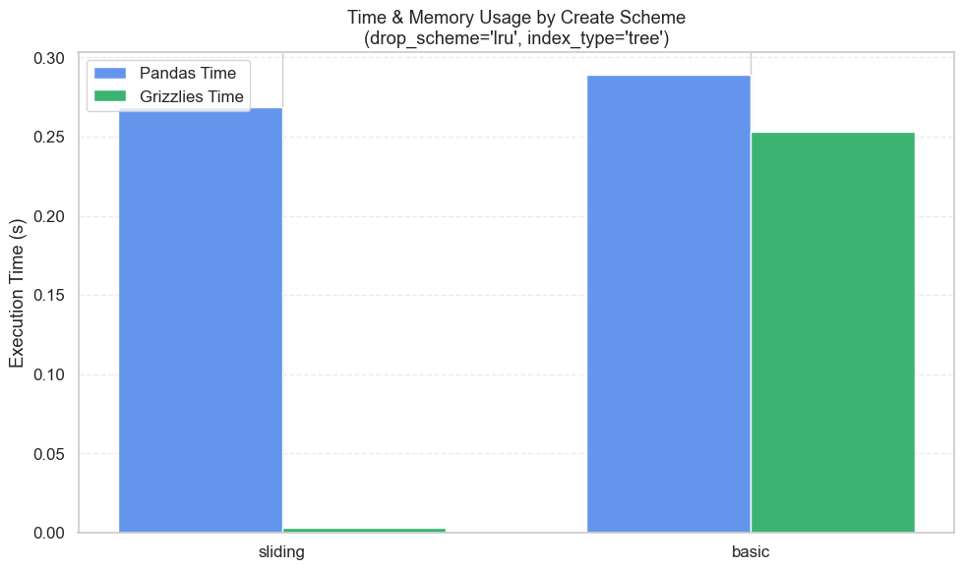
Index Creation Scheme

Slide 17
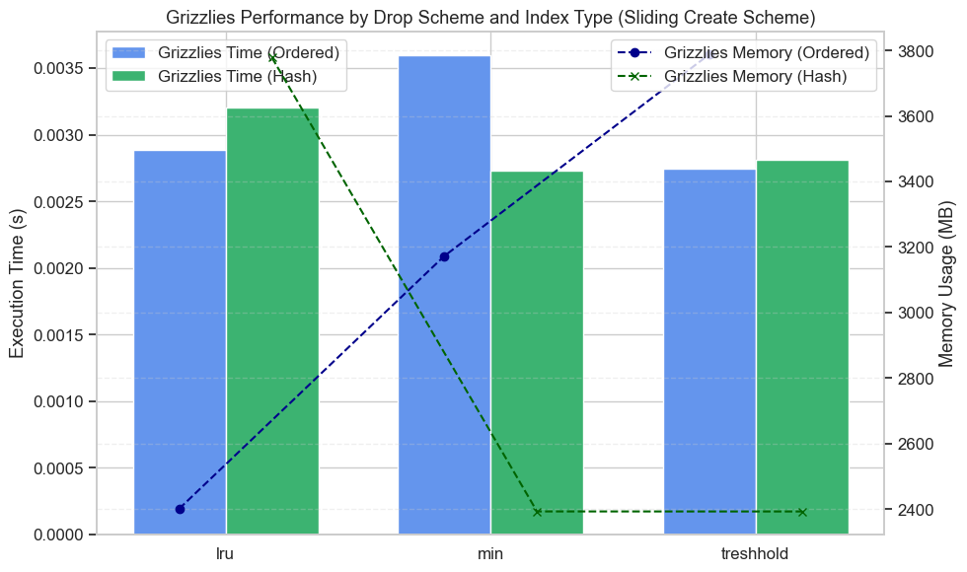
Comparison of Drop Schemes and Index Types

Slide 18
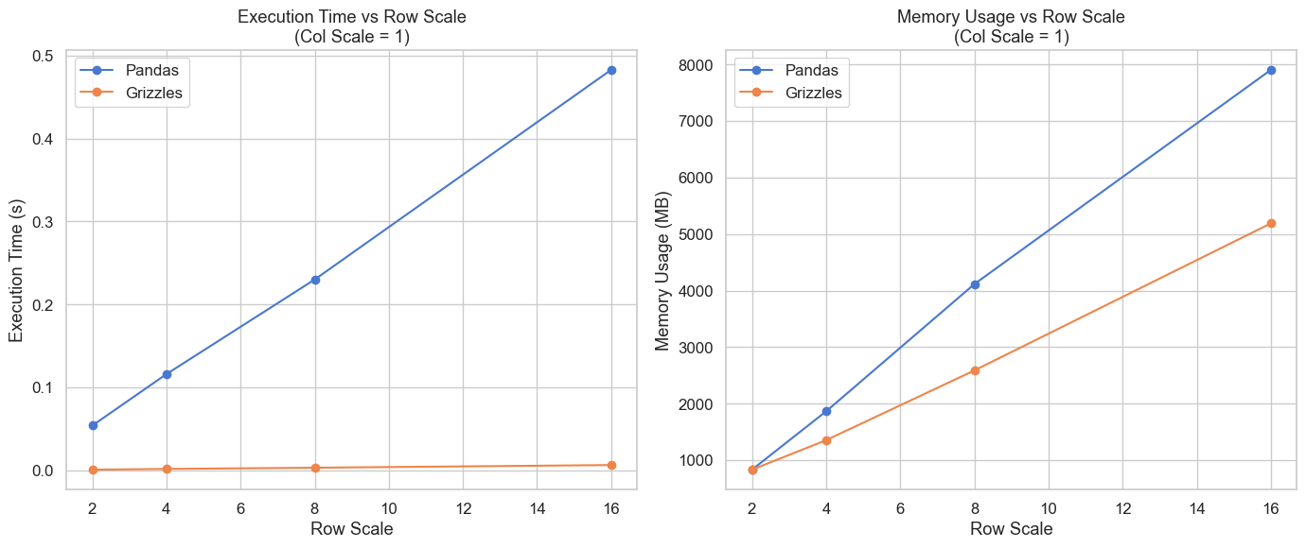
Scaling of Rows

Slide 19
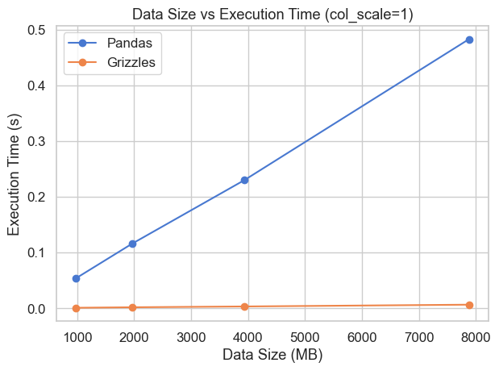
Scaling of Rows

Slide 20
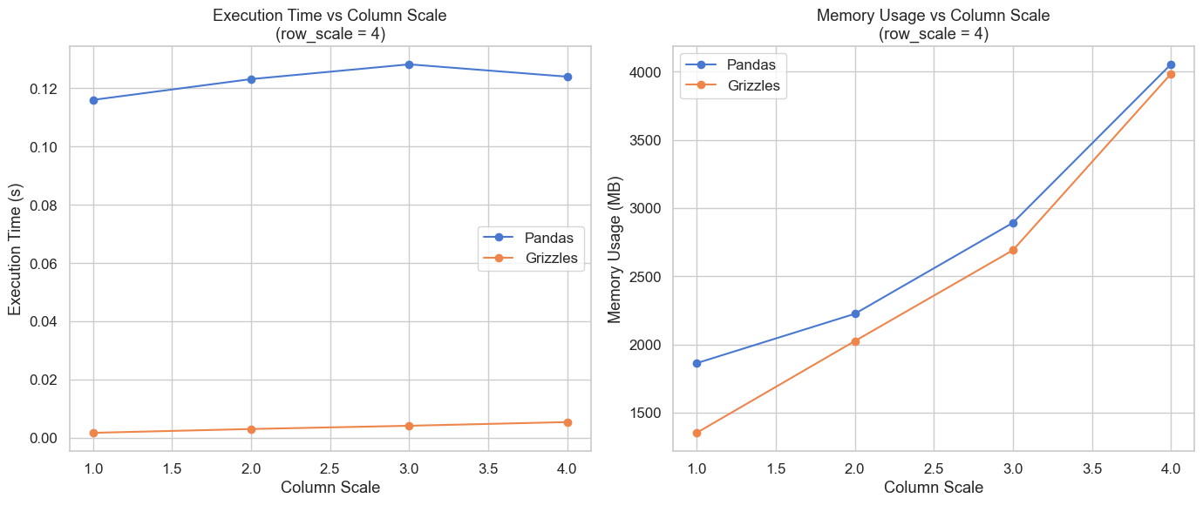
Scaling of Columns

Slide 21
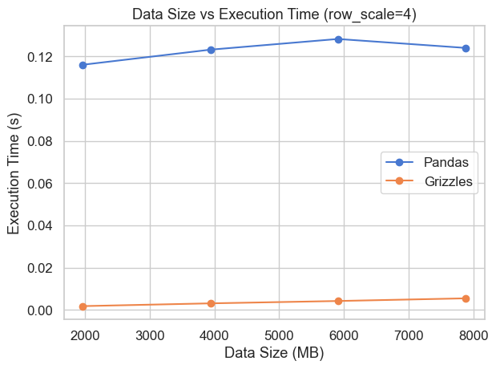
Scaling of Columns

Slide 22
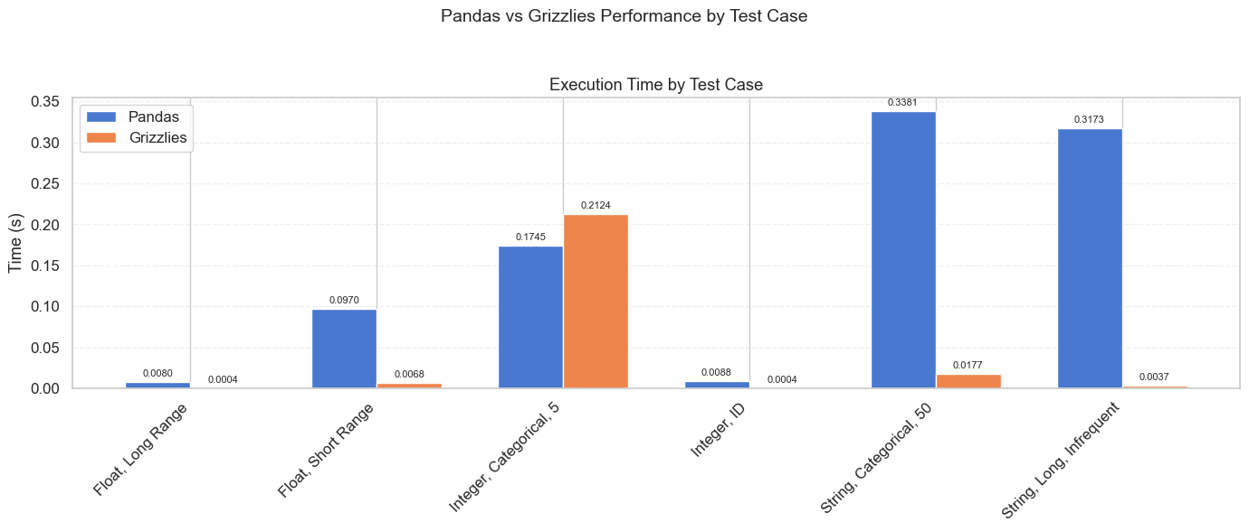
Data Characteristics and Index Performance

Slide 23
Data Characteristics and Index Performance
 | Integer Categorical (n = 5) | Integer ID | String Categorical (n=50) | Long String Less frequent | Float Range bounded | Float Unbounded
Pandas | 0.174498 | 0.008795 | 0.338094 | 0.317349 | 0.097022 | 0.00796
Grizzlies | 0.212354 | 0.000392 | 0.017697 | 0.003740 | 0.006804 | 0.000431

Slide 24
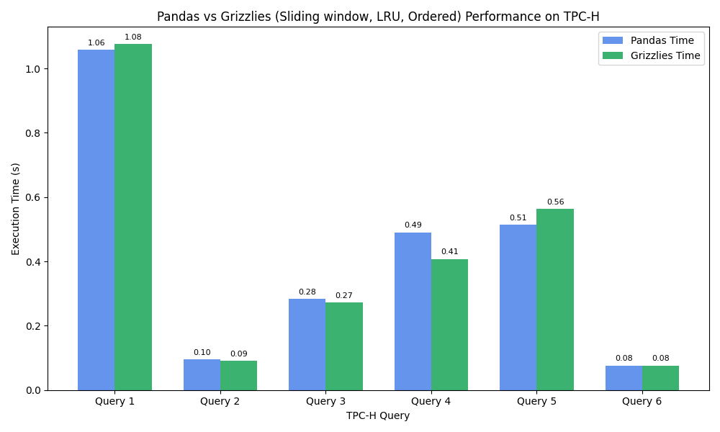
Pandas vs Grizzlies on TPC-H Benchmarks

Slide 25
Remaining Steps
05
Notes:
shank

Slide 26
Future Steps - Improving Heuristics
Memory-Based
N-Unique
Index Types
Continue creating indexes while memory permits
Only create indexes if a column has a certain proportion of unique values
Create both Hash-based and Tree-based indexes depending on user behavior
Track Query Performance
Hyperparameter tuning
New Name for Grizzlies
Maintain execution stats and delete indexes when degrade performance
Finding best parameters for each scheme
Call it Pandas Express
Notes:
Top row: Creation heuristics
Bottom row: Drop heuristics
shank

